Slide 1







Technology of Future
Venkata Sai Abhiram Addepalli
2nd May 2024

Slide 2



OUTLINE
Executive Summary
Introduction
Methodology
Results
Visualization – Charts
Dashboard
Discussion
Findings & Implications
Conclusion
Appendix

Slide 3

EXECUTIVE SUMMARY
Gathering job demand data across different technologies and locations.
Analyzing the data to uncover insights and trends. Identifying the most in-demand programming languages.
Determining the top database skills sought by employers
Determining the top database skills sought by employers.
Recognizing the popular Integrated Development Environments (IDEs).
Presenting the information through a dashboard displaying current skills, future skill trends, and demographic data.

Slide 4

INTRODUCTION
To stay updated with evolving technologies, it’s crucial for IT professionals and consultants to excel in programming.
The purpose of the problems
Identify the skill requirement
Identifying the programming/database skills for present
Identifying the programming/database skills for future
Data was gathered from a Stack overflow survey, IBM site and GitHub postings. It was collected, cleaned, subjected to exploratory analysis, and visualized on dashboard.

Slide 5

METHODOLOGY
Data Collection
Data Scrapping
Data Wrangling
Exploring Data Analysis
Data Visualization
Dashboard Creation
Presenting the Findings

Slide 6
RESULTS
The gathered data undergoes a cleaning process before statistical techniques are applied for analysis. Once completed, the information is used to create dashboards illustrating current and future trends. \
The following are the findings and visual representations of the results, accompanied by explanations.

Slide 7
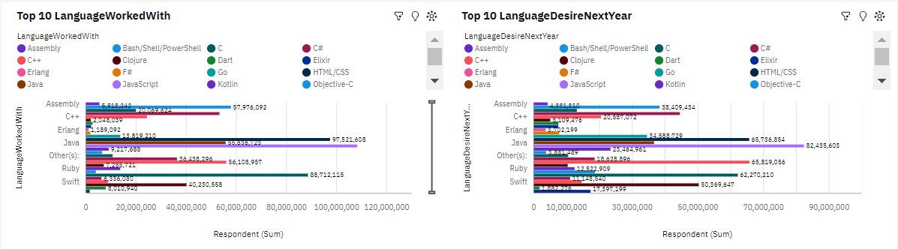
PROGRAMMING LANGUAGE TRENDS
Current Year
Next Year

Slide 8
PROGRAMMING LANGUAGE TRENDS - FINDINGS & IMPLICATIONS
Findings
JavaScript is the most highest number of people working with, following by HTML/CSS for both
• The third is replaced by Python
• TypeScript is expected to be in the 5th place, while the Bash/Shell/PowerShell is out
Implications
JavaScript and HTML/CSS will be still in the trends
People are more interested in Python
SQL will be still preferable

Slide 9
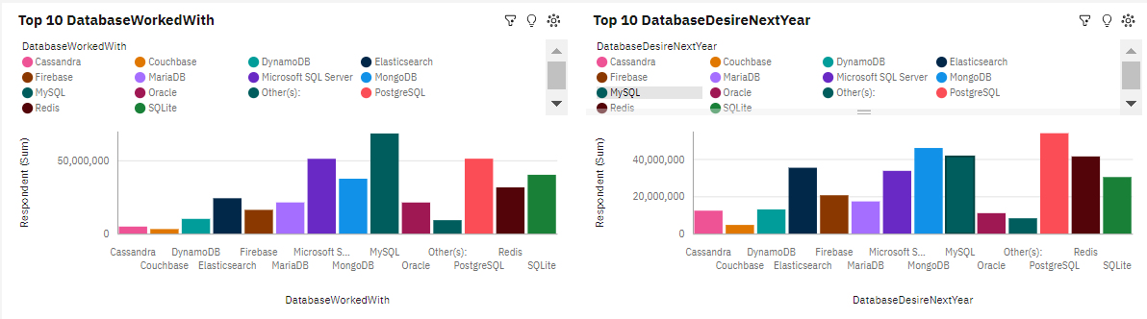
DATABASE TRENDS
Current Year
Next Year

Slide 10
DATABASE TRENDS - FINDINGS & IMPLICATIONS
Findings
In next year, PostgreSQL is presented to be the 1st place instead MySQL
MongoDB is changed from 5th to 2nd place
Microsoft SQL Server and SQLite is estimated to be replaced by Radish and Elasticsearch
Implications
MySQL will be the most requirement to use
MongoDB will be much more popular
Radish and Elasticsearch will be used in the top 5th used databases

Slide 11

DASHBOARD
The GitHub link of the Cognos dashboard click here

Slide 12
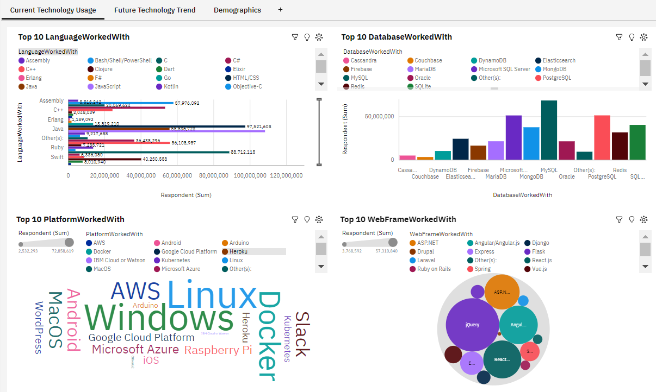
DASHBOARD TAB 1

Slide 13
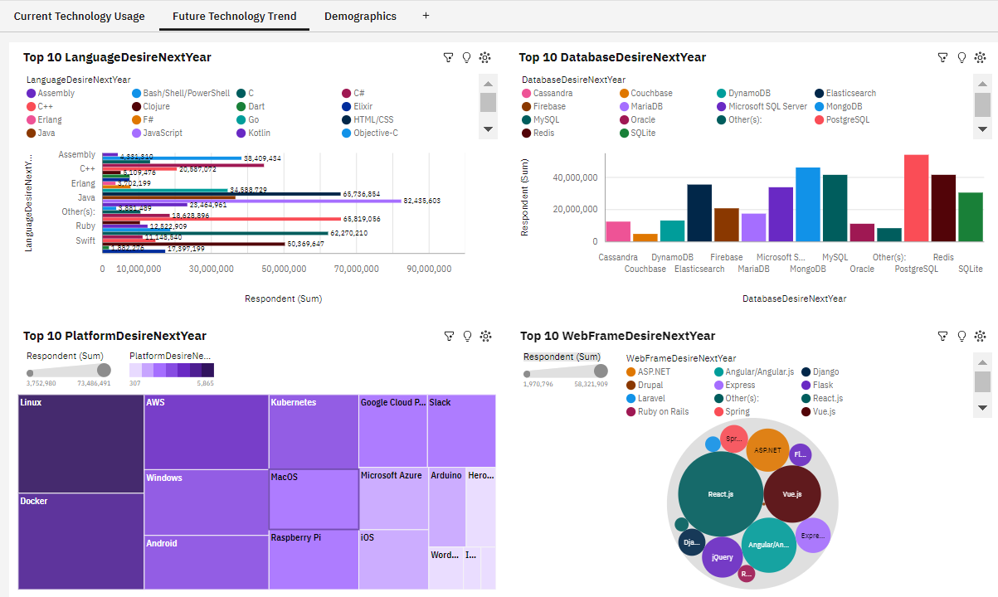
DASHBOARD TAB 2

Slide 14
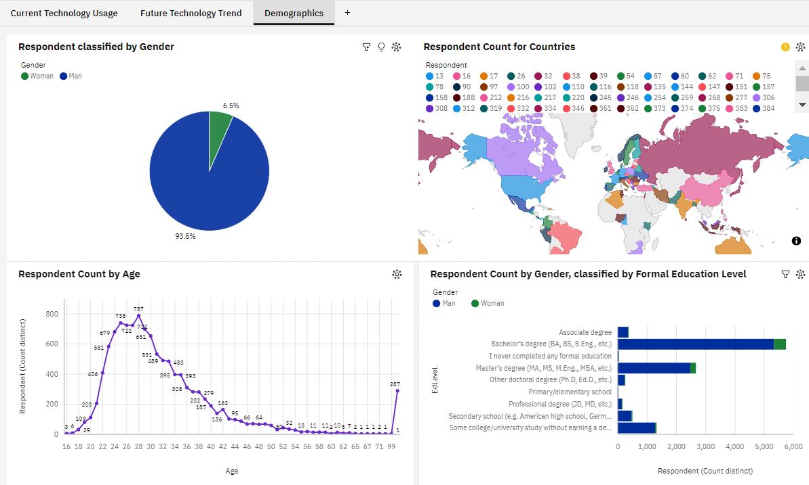
DASHBOARD TAB 3

Slide 15
DISCUSSION
Technology Trends
Reskilling Workers
Gender Equality
Adaptation of new Technology
Using Popular platforms
Hiring new Tech Workers

Slide 16
OVERALL FINDINGS & IMPLICATIONS
Findings
By next year, JavaScript and HTML/CSS will be remained in the top 1st and 2nd
While SQL is going to be surpassed by Python, Bash/Shell/PowerShell are not shown in the next year
PostgreSQL is presented to be the 1st place instead MySQL, compared with disappearing of Microsoft SQL Server and SQLite
Platform Linux is the largest proportion, while windows will be replaced by Docker
ReactJs is predicted to be the highest preference of Web Frame in the next year instead of Query
By gender, men is shown respondence more than women which the most number presented in Russia Federation and age around 28 who have Bachelor's degree
Implications
JavaScript and HTML/CSS will be continue popular
Python is going to be more interested
SQL servers will be required but the most popular database is expected to be PostgreSQL
Docker is more preferred as much as Linux
The demand of jQuery is decreasing
It is assumed that The large number of young Russian men who have Bachelor's degree tend to response in the analysis

Slide 17

CONCLUSION
Technology Trends
Demographics Overviews
Future Skills and preferences
Technology to Adapt
Preferred Actions

Slide 18

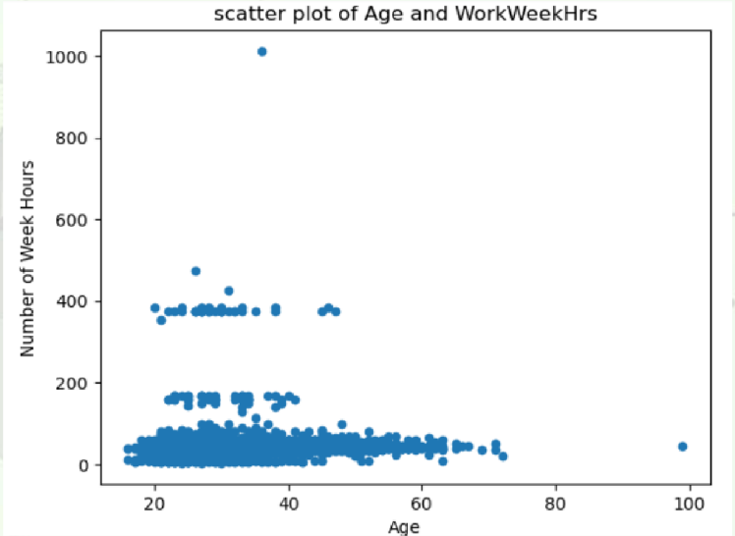
APPENDIX

Slide 19
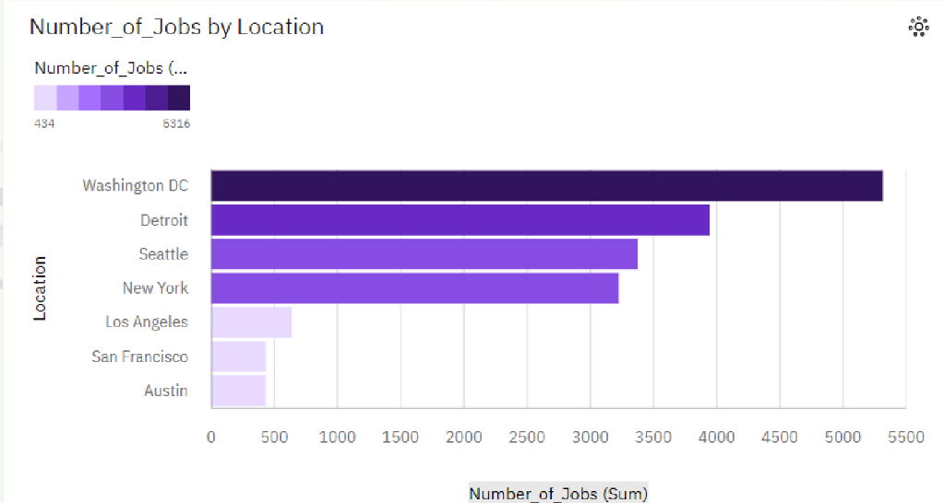
JOB POSTINGS

Slide 20
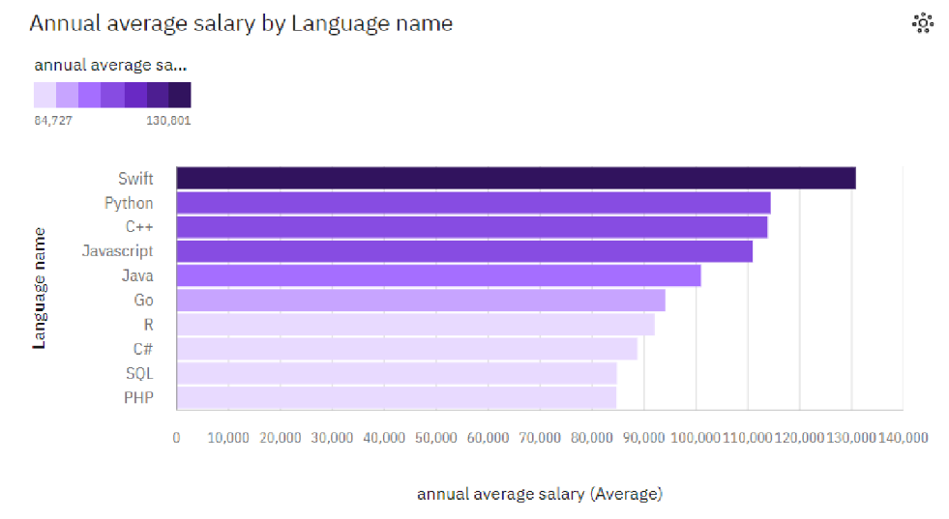
POPULAR LANGUAGES

